Slide 1
Leave Request Application
Power Apps
DTT Final Project
Group Members:
Khawaja Abdullah (20K-0385)
Syed Ahmed Ali (19K-1353)
Ahad Sheikh (20K-0319)
Shayan (20K-0186)

Slide 2
Problem Statement
In many organizations, the process of requesting, approving, and managing employee leave is often manual and inconvenient.
Employees may face delays in receiving approvals for their leave requests, and managers may struggle to maintain accurate records of their team's leave schedules, leading to potential conflict
These issues can result in decreased employee satisfaction, increased administrative workload, and potential negative impacts on overall productivity and disruptions in workflow.

Slide 3
Real-World Scenario
Imagine a mid-sized corporate office, ABC Corp, which employs around 200 people. They recently implemented a Leave Request Application to streamline their leave management process.
Ahmed, a marketing executive at ABC Corp, plans to take a two-week vacation in July. He needs to coordinate his leave with his project deadlines and ensure his absence doesn't disrupt his team's workflow.
Using the Leave Request Application, Ahmed submits his request if he has his annual leaves left ,which is automatically routed to his manager, Ali, for approval.
Ali gets a reminder daily in the morning to Approve Leaves.
Satisfied that Ahmed’s absence won't negatively impact the team, Ali approves his request status and the Update is emailed to Ahmed.

Slide 4
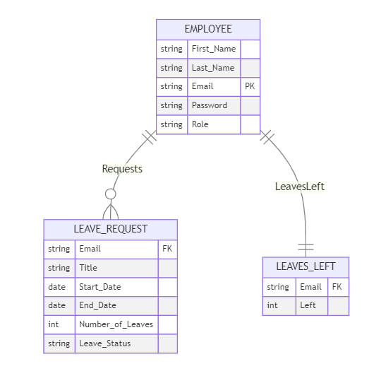
ERD
Each employee can have multiple leave requests, while each leave request is associated with one employee.
Each Employee will have only 1 record each for his Leaves Left

Slide 5
Flow
Employee Logins and routed according to his role
Employee
Manager
Fills the form for Leave Request . Form is validated based on many rules
Approve Leaves Status
Gets an Email whenever his leave status is updated
Receives Email daily regarding the leaves whose Status is yet to be updated

Slide 6
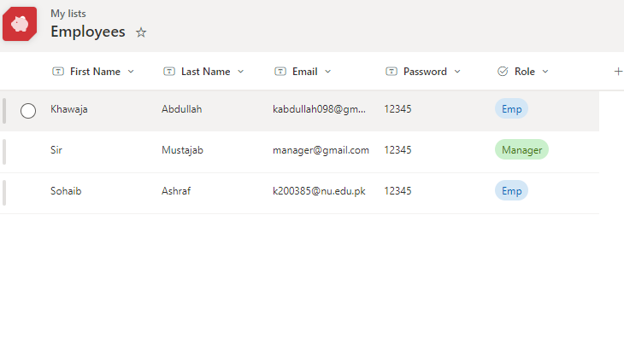
SharePoint Lists
Employee Details:
Unique Email
2 Choices for Role: Emp or Manager

Slide 7
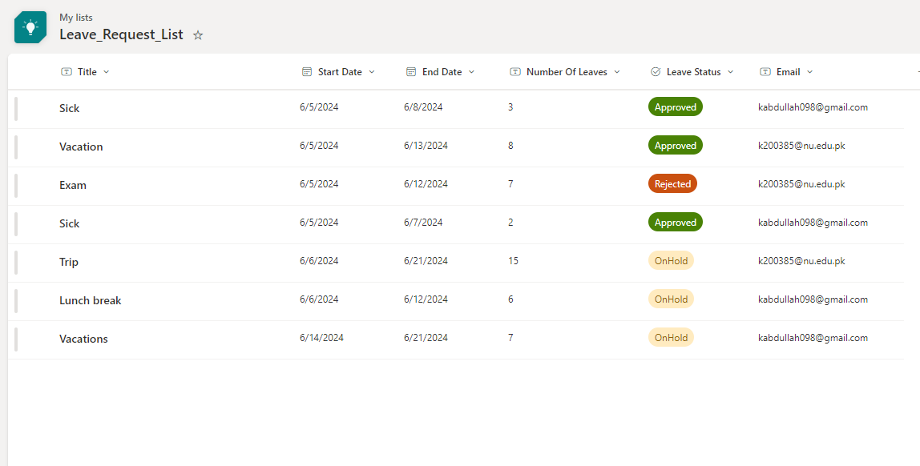
SharePoint Lists
Leave Request Details
Reason for The leave
3 Choices for Status: OnHold, Approved,Rejected

Slide 8
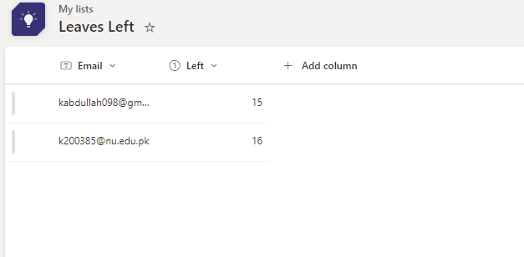
SharePoint Lists
Leave Left:
Stores the Number of Leaves Left for Each Employee.(Default 30 Leaves Allowed)
Value is decremented if The Status of leave is changed to Approved.

Slide 9
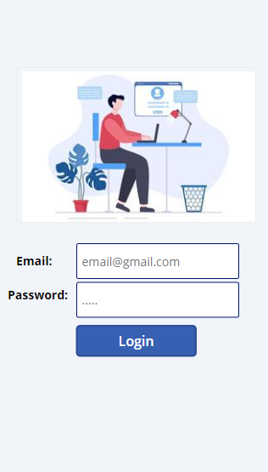
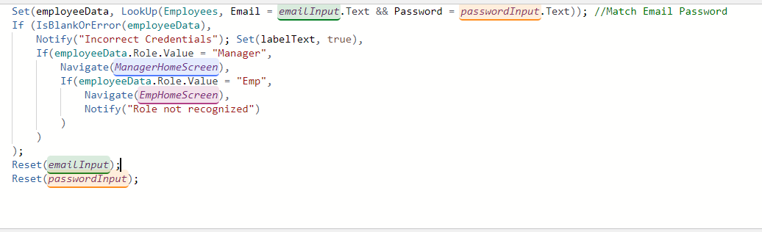
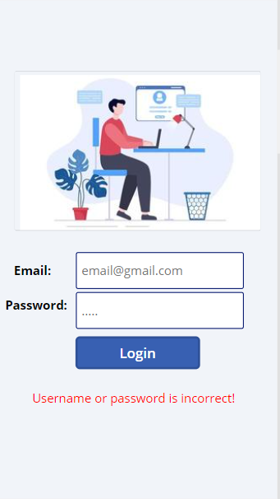
Role Based Login
Match User’s Email and Password
Navigate User based on his role
Show error message if credentials are incorrect
Reset input boxes
A variable (false by default) is set as visible property of this label
If credentials don’t match, it is set to true and the label shows up

Slide 10
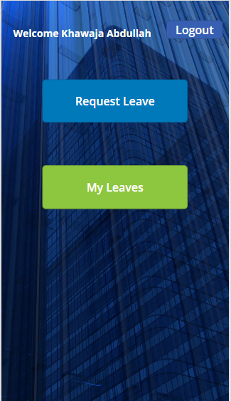

Employee Home Screen
During Login, We set a variable named employeeData and stored employee information like a session or global variable)
Using this we can display Employee’s first name and last name

Slide 11
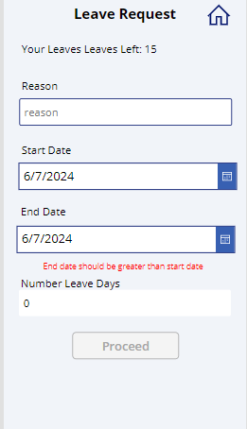
Request Leave
Dropdown for starting and Ending Date
Read only Column
Calculates the number of days of the leave automatically using the formula we have set for the Default property shown below:

Slide 12
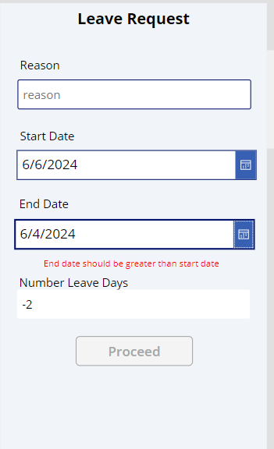
Request Leave Validations
If End date is smaller than starting date, then we cannot proceed forward and it shows an error. We did this by applying the formula on this Label’s Visible property:

Slide 13
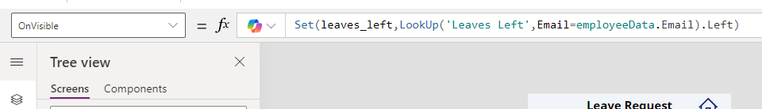
Request Leave Validations
OnVisible property of this screen is set to Get Employee’s leaves Left at that time

Slide 14
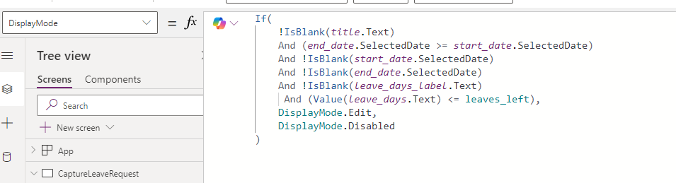
Request Leave Validations
The Display mode of the Proceed button Is set as Disabled if:
The user has not entered all the fields.
The number of leaves entered by Employee are more than the number of Leaves Left.

Slide 15
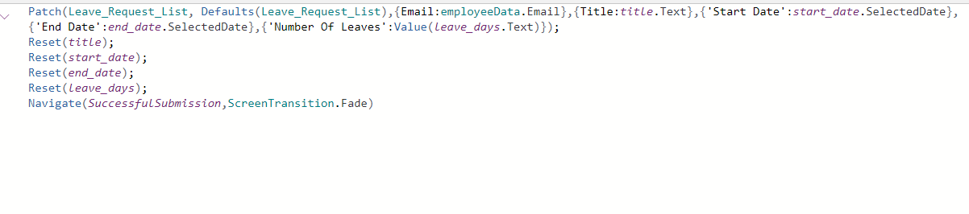
Insert in SharePoint List
Patch function used to insert record in our Data source (Sharepoint List)

Slide 16
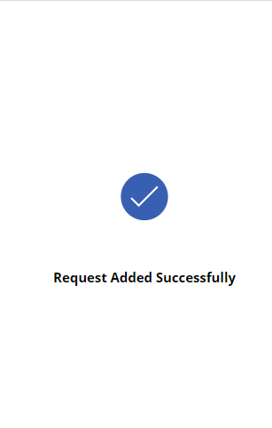
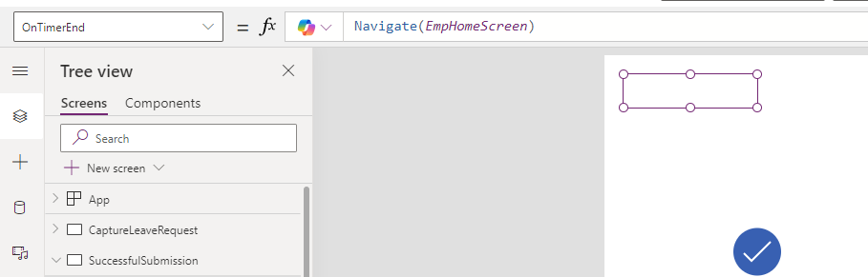
Timer
After Successful insertion of our Leave request a success screen is shown for 2.5 seconds using Timer
Duration proportion of Timer is set to 2500
OnTimerEnd property is set to Navigate() function which navigates user back to Homepage

Slide 17
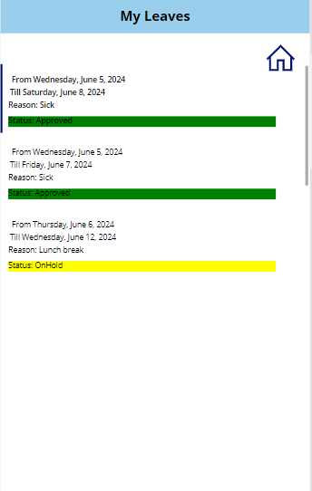
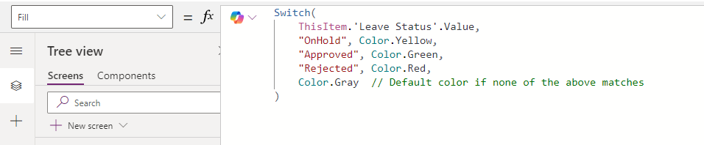
Gallery
User can see his Leave requests He has made and its status
Different colors based on the Request Status are rendered using Switch Statement on the Fill property of the Status Body

Slide 18
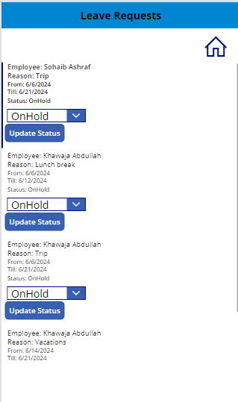
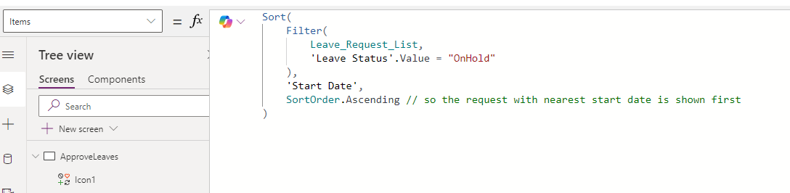
Approve Leaves By Manager
Using Gallery, Manager can see Leave Requests and can Approve Leagues by changing the status of the Request.
We filter the Leave Requests on this page on the basis of status to only show the Requests whose status is “OnHold”.
We also sorted the list based on Leave starting date so the earliest starting leave can be shown first

Slide 19
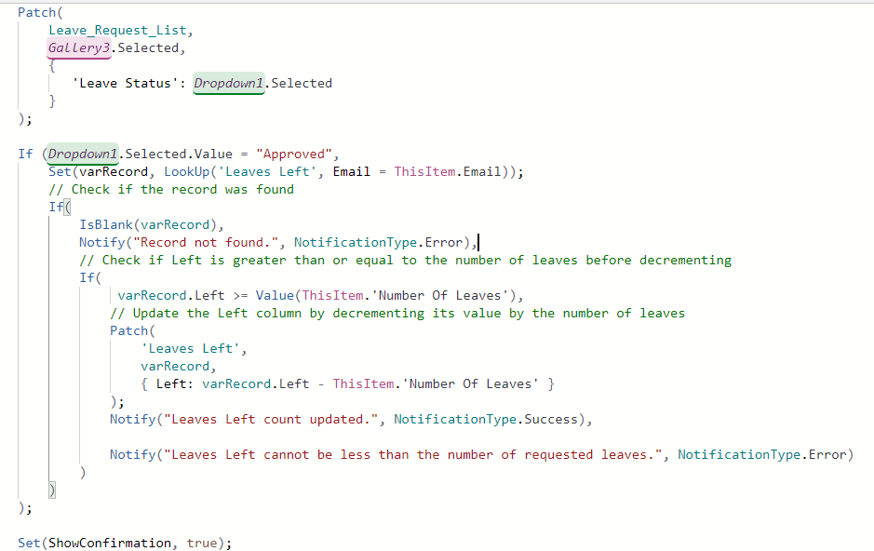
Approve Leaves By Manager
On changing the Status, The Record in our Data source
( Share Point) is updated.
If the status is changed to Approved, The leaves count is also updated

Slide 20
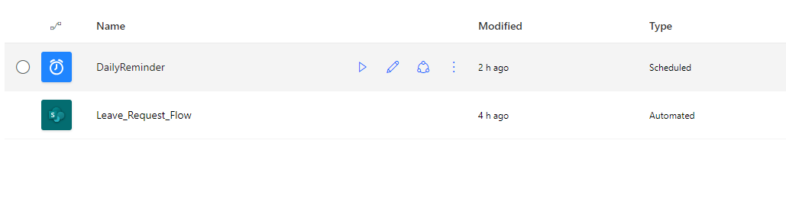
Power Automate
2 Flows Used
1 Automated Flow
1 Scheduled Flow

Slide 21
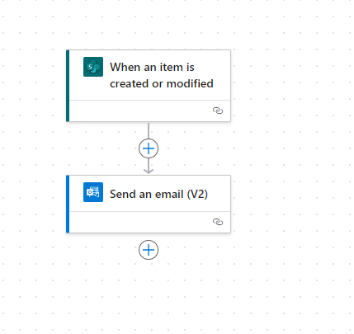
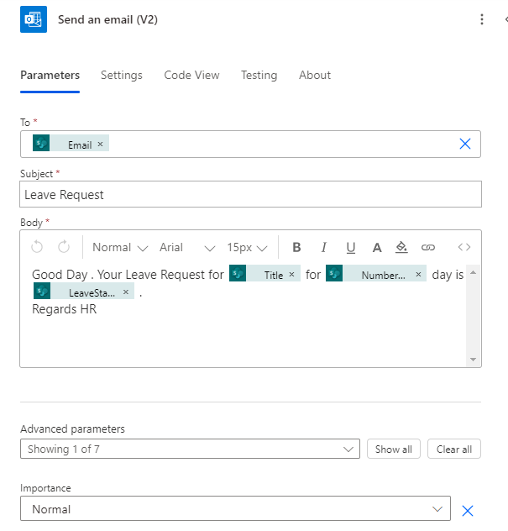
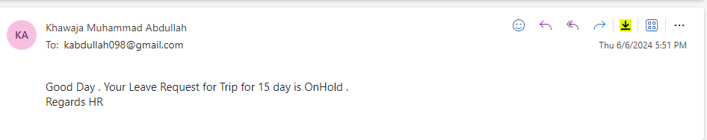
Leave Request Flow
- It Runs whenever our Status column is updated and send email to the employee.
- Dynamic Data is used to
display correct results
to that employee
Email:

Slide 22
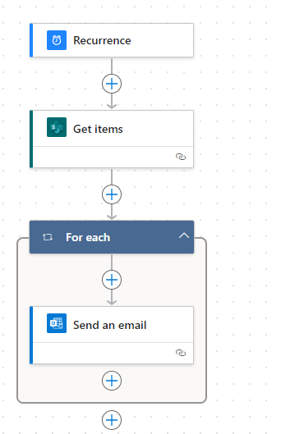
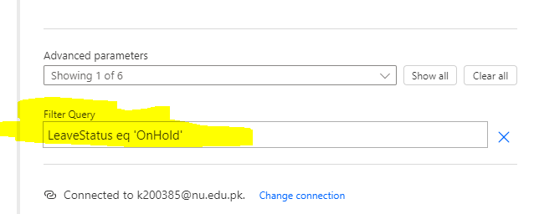
Scheduled Flow (Daily Reminder)
Send Email to the Manager Daily about the Leaves whose Status is “OnHold”.
GetItems Action to Filter records
Used ODATA to filter out the Records
Then Email each Record

